Slide 1

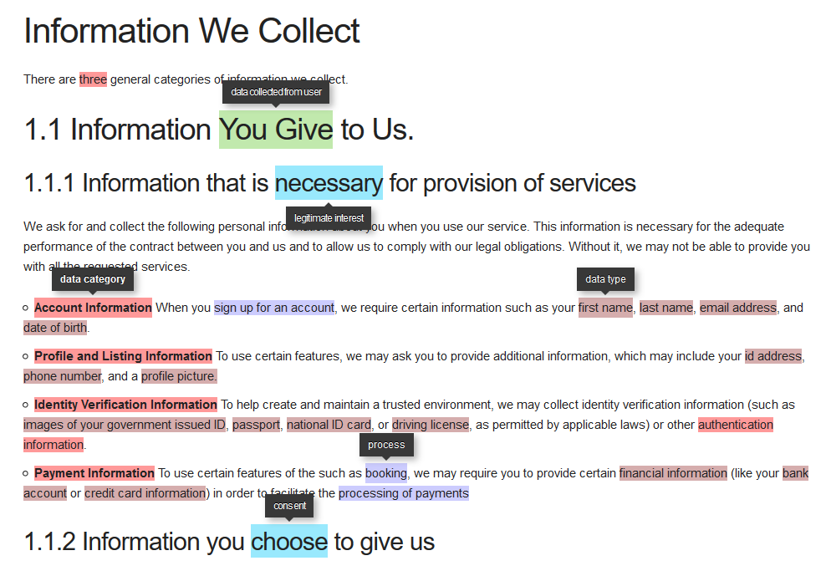
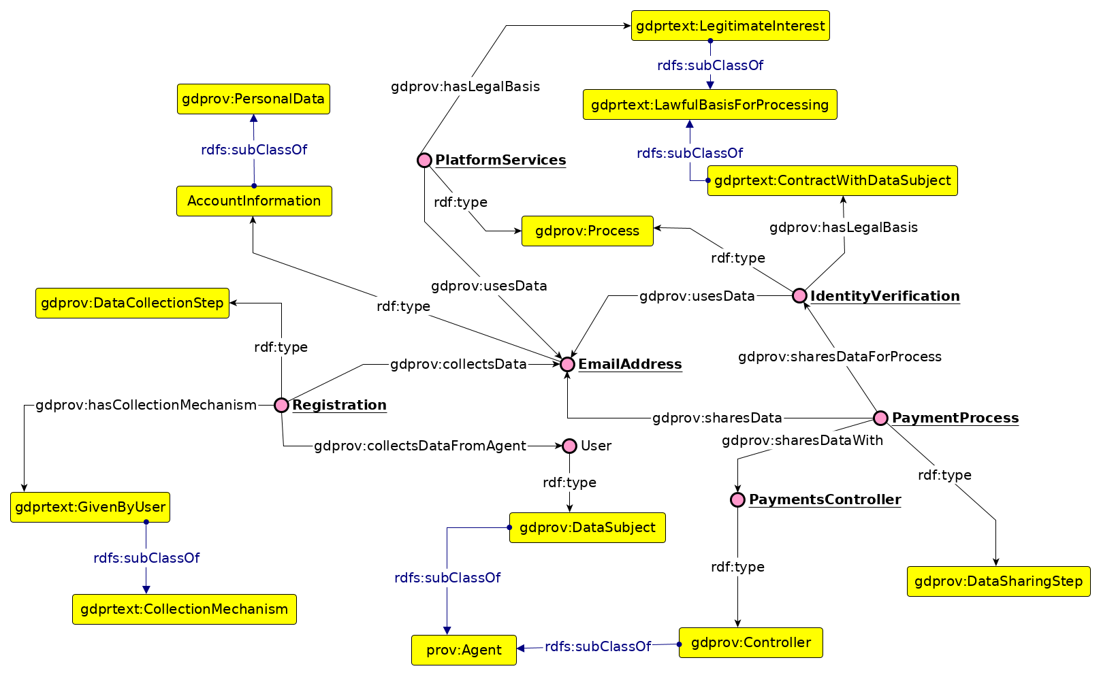

An ODP for Describing Personal Data in Privacy Policies
Harshvardhan J. Pandit, Declan O'Sullivan, Dave Lewis
ADAPT Centre, Trinity College Dublin, Dublin, Ireland { harshvardhan.pandit | declan.osullivan | dave.lewis } @ adaptcentre.ie
@coolharsh55 https://openscience.adaptcentre.ie/
Problem Domain
Privacy Policy is a legal document that specifies information regarding the use of Personal Data amongst other things.
This information needs to be represented as machine-readable metadata to enable machine-based approaches over it.
Approaches that work with Privacy Policies have their own internal representation of this metadata specific to their aims.
It is difficult to garner consistency and standardisation on privacy policies as a document itself.
Solution Sphere
Annotated Airbnb Ireland Privacy Policy [1]
Identify relevant information that is common to all privacy policies.
Incorporate legal requirements from General Data Protection Regulation (GDPR).
Use existing vocabularies to represent concepts and relations.
Define an ODP that can be incorporated into ontologies or used as a mapping between approaches.
Create a corpus of privacy policy metadata using ODP → future work!
Ontology Design Pattern
Ontologies Re-used
GDPRov [2]
- represent provenence
- extends PROV-O [3] ; P-Plan [4]
GDPRtEXT [5]
- concepts and terms from GDPR
- provides legal basis
Future Work
Towards an ontology for representing the entirety of Privacy Policy as a document.
Re-publish existing corpus of privacy policies using ODP.
Create dataset from new policies for GDPR (post 25 May 2018)
[1] Privacy Policy http://openscience.adaptcentre.ie/privacy-policy/personalise/demo/policy.html Re-used under CC-by-4.0
[2] GDPRov – GDPR Provenance Vocabulary https://w3id.org/GDPRov
[3] PROV-O: The PROV Ontology. W3C Recommendation 30 April 2013. http://www.w3.org/TR/prov-o/
[4] The P-PLAN Ontology. Release 12 March 2014. http://purl.org/net/p-plan
[5] GDPRtEXT – GDPR Text Extensions. https://w3id.org/GDPRtEXT
Presented at 9th Workshop on Ontology Design Patterns (WOP2018)
Co-located with 17th International Semantic Web Conference (ISWC2018)
The ADAPT Centre for Digital Content Technology is funded under the SFI Research Centres Programme
(Grant 13/RC/2106) and is co-funded under the European Regional Development Fund.
Notes:
Notes
Do not change font size – check with us if you really cannot make the space work for you

